Slide 1
IP Routers
Exercises ANS
Lecture 7 (Routing 4)
Slides credit: CS 168 @ UC Berkeley
Notes:
Slides template credit: Josh Hug, Lisa Yan
okay so today's all about IP routers we're continuing the whole section on routing and so far remember
0:36
we've talked about distance Vector routing link state routing then we talked about using IP addressing to make
0:44
routing scalable today is kind of a detour before we continue talking about interdomain routing

Slide 2
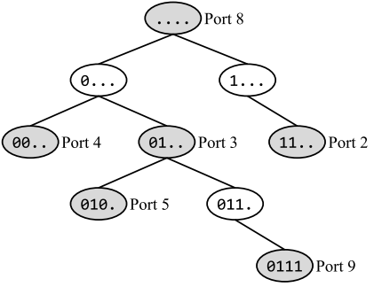
Q1. Longest Prefix Matching
In this question, consider the longest-prefix-matching trie below. All subparts are independent.
How many of the 16 possible 4-bit IP prefixes are forwarded along the default route?
In this subpart only, suppose we delete the node labeled 010. (Port 5). How many of the 16 possible 4-bit IP prefixes are forwarded along a different port using the modified trie (compared to the original trie)?
Which of these IP prefixes represents exactly the set of IPv4 addresses that will get forwarded along Port 2?
How many 32-bit IPv4 addresses are forwarded along Port 3?

